Slide 1

Travel Indicator
Application that tells you different routes by which you can travel from Kalyan to Vidyavihar local via fast and slow trains.
Made by:
Pratik Panchal 16010221022
Eshan Trivedi 16010221038

Slide 2
Why we need travel indicator
In a city like Mumbai travelling by local train is the best way to explore the city and to get know of its beauty. Travel indicator is a buddy app that eases your travel by telling u the shortest distance between two stations.

Slide 3
Data structure used:
Graphs:
Graphs in data structures are used to represent the relationships betweenobjects. Every graph consists of a set of points known as vertices or nodesconnected by lines known as edges.

Slide 4
What is a weighted graph?
A weighted graph is a graph in which each branch is given a numerical weight. A weighted graph is therefore a special type of labeled graph in which the labels are numbers (which are usually taken to be positive).

Slide 5
Algorithm used:
Dijkstra’s Shortest Path Algorithm.. Dijkstra's algorithm is an algorithm for finding the shortest paths between nodes in a graph, which may represent, for example, road networks ,train network . It was conceived by computer scientist Edsger W. Dijkstra in1956 and published three years later. The algorithm exists in many variants.

Slide 6
Implementation:
To view full code click here

Slide 7
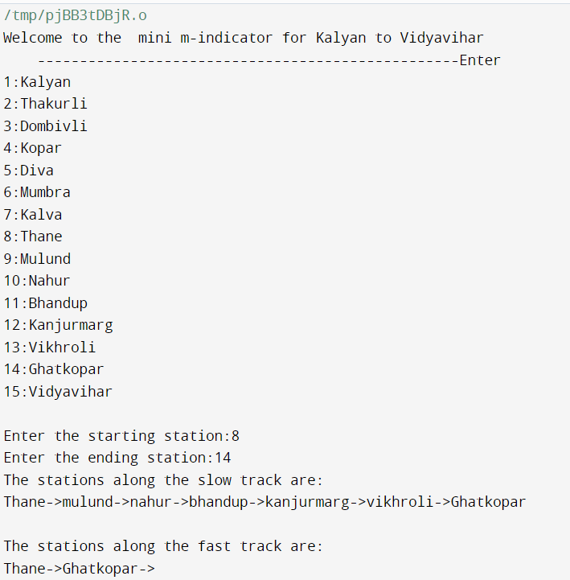
Output

Slide 8
Thank You

